Slide 1
BLUE ZONE
N Dhatri Sahithi 1602-16-737-010
R Praneela 1602-16-737-029
Hyndavi Vennu 1602-16-737-016

Slide 2
Problem Statement
Air pollution is most common in large cities where emissions from many different sources are concentrated, among them the major sources are automobiles and industries.
People experience a wide range of health effects from being exposed to air pollution.
A legitimate information of air quality is needed to help us from getting exposed to air pollution.

Slide 3
Motivation to our idea!!
The idea is based on our personal experience.
While travelling to different places, we usually get stuck in traffic and get exposed to pollution which has many effects on a large section of people.
So providing with a better route can reduce the effect.

Slide 4
USE CASE 1:
By using live location tracking , we can tell the user the amount of pollution in a certain place which is along the route and provide them with a route with lesser pollution
The user can then change his route and avoid pollution.

Slide 5
USE CASE 2:
Along with the pollution detection people can be updated about the status of Air quality index of other countries
They can be updated about the measures taken to control pollution , the organizations working towards reducing pollution , the fund collections aiming to reduce pollution , and the government policies to protect environment.

Slide 6
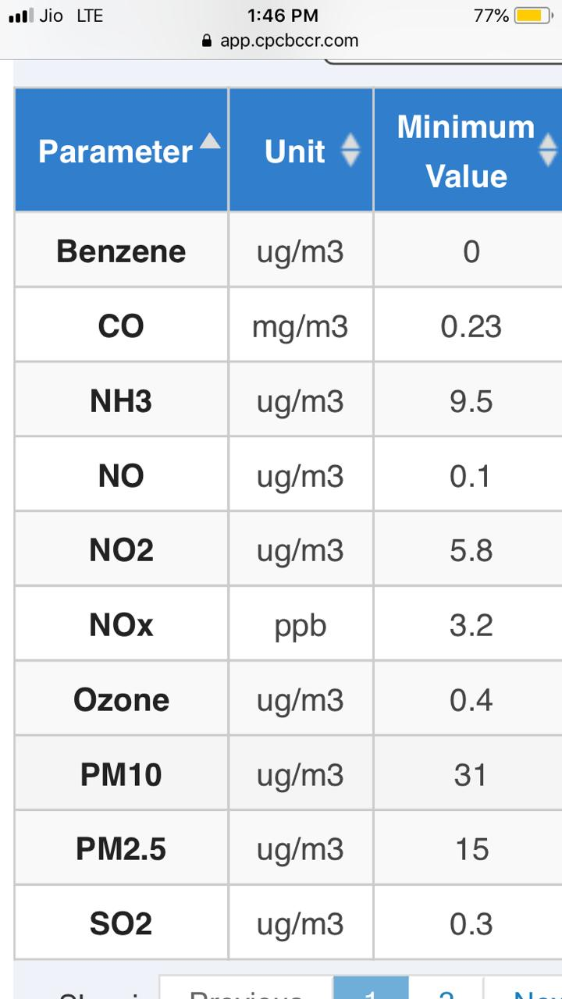
USE CASE 3:
We can monitor the amount and type of gases that people are being exposed to.
People with health issues can avoid routes that may cause harm due to certain gases .

Slide 7
Overall Architecture
The whole application will be implemented using django.
HTML,CSS,JAVASCRIPT will be used for front end.
JavaScript Google maps API is used to get the geographical location of a user and facilitate live location tracking
The Maps JavaScript API is used to customize maps with our owns content and imagery for display on web page

Slide 8
Thank You

